Slide 1
PREDICTING THE CASE STATUS FOR H1B APPLICANTS
Prepared By:
Anurag Aman
Krutarth Trivedi
Rajit Gohel
Vinay Nayar
Ishan Sahu

Slide 2

Krutarth Trivedi
Anurag Aman
Rajit Goel
Vinay Nayar
Ishan Sahu

Slide 3
Business Problem Overview
Every year, employers file H-1B applications for thousands of their employees and only a fraction of those applications are accepted.
It is quite obvious that the process of filing, reviewing and making a decision on the received applications is a tedious job and involves a lot of resources in the form of time, money and labor.
The project goal is to develop a model that can predict the case status of an application submitted by the employer to hire non-immigrant workers under the H-1B visa program and to discover insights that can help employers understand the application process.

Slide 4
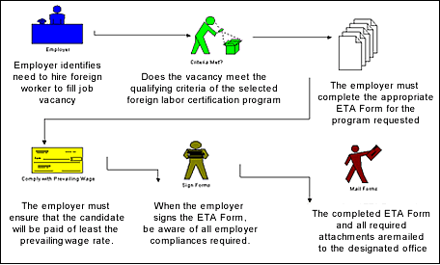
Foreign Labor Certification Program

Slide 5
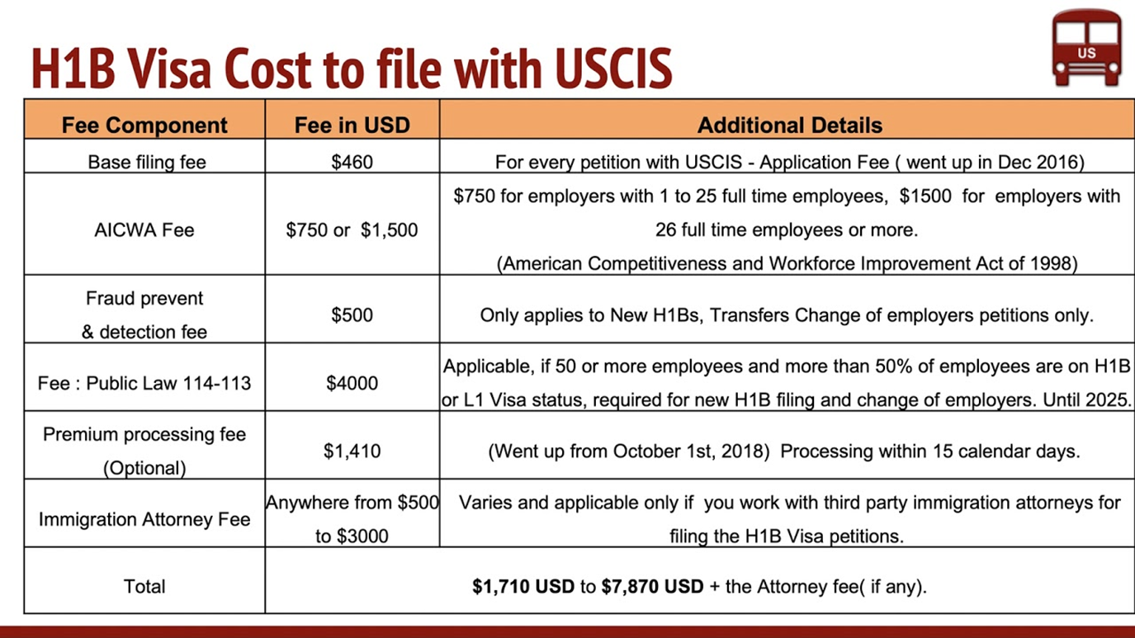
Literature Review

Slide 6
Goal and Objective
The generated model should be able to accurately classify the H1B application as either “certified” or “certified_withdrawn” or ”withdrawn” or “denied”
The model shall allow the user to perform a preliminary analysis of their application based on H1B application decisions made in the recent past

Slide 7
Road Map
Data Scraping
Understanding the problem
Data Mining
Algorithm Selection
Data Cleaning
Test different classification models
Compare Model Accuracy
Best Model Selection

Slide 8
Data Understanding
The data is taken from Foreign Labor Certification website https://www.foreignlaborcert.doleta.gov/performancedata.cfm
Dataset Details :
The dataset contains 6.6 lakh data entries and 56 variables for each entry
The dataset was created in the year 2019 and was the most recent dataset I could find to address the business question
Sample Dataset
Due to the dimensions of the dataset, it was impossible to include a sample dataset in presentation format
Attribute Details
The dataset provides information on 56 attributes associated with the H1B applications which can be divided into classes for a more accurate understanding.

Slide 9
Attribute Details
Application Attributes
1. case_number
2. case_submitted
3. visa_class
4. decision_date
5. soc_code- Social Code, which defines the profession
6. soc_name- Profession of the employee

Slide 10
Attributes Details
Employer Attributes
1.employer_name
2.employer_address
3.employer_city
4.employer_state
5.employer_postal_code
6.employer_country
7.employer_province
8.employer_phone
9.employer_phone_ext
10.agent_attorney_name
11.agent_attorney_city
12.agent_attorney_state

Slide 11
Attribute Details
Employee Attributes
1.employment_start_date
2.employment_end_date
3.job_title
4.soc_code
5.soc_name
6.naics_code
7.total_workers
8.full_time_position
9.prevailing_wage
10.pw_unit_of_pay
11.pw_source
12.pw_source_year
13.pw_source_other
14.wage_rate_of_pay_from
15.wage_rate_of_pay_to
16.wage_unit_of_pay
17.h-1b_dependent
18. willful_violator
19. worksite_city
20.worksite_county
21.worksite_state
22.worksite_postal_code
23.original_cert_date

Slide 12
Data Cleaning
Irrelevant Variables-
During the data exploration phase, we found a few variables that were irrelevant to the modeling approach due to the presence of either too many unique values (Case_number) or due to having a constant value (Employment_country)
The data attributes identified for such elimination are
1.Case Number- since it is just a serial number for each application
2.Visa Class- Since our dataset only contains F1B applications
3.Agent Attorney (and other correlated variables)
4.Employer Phone and Employer Extension
5.NAICS Code- Since there is no meaning being added to the model
6.Employer Country-constant

Slide 13
Data Cleaning
Missing Values, N/a Values and Null Values
We have used two approaches for cleaning of missing data-
1.Eliminating columns with high percentage of missing values-
Any variable with more than 90% missing variables is not contributing much to the modeling effort and might affect the quality of the model and hence the overall analysis
2. Missing data entries-
The data set had a total of approx 12,000 rows with missing data and since that is less than 3% of the total data. We chose to delete any such rows to reduce complexity.
3. n-tile grouping-
We have used n-tile on prevailing wages to bring data on similar analysis scale.

Slide 14
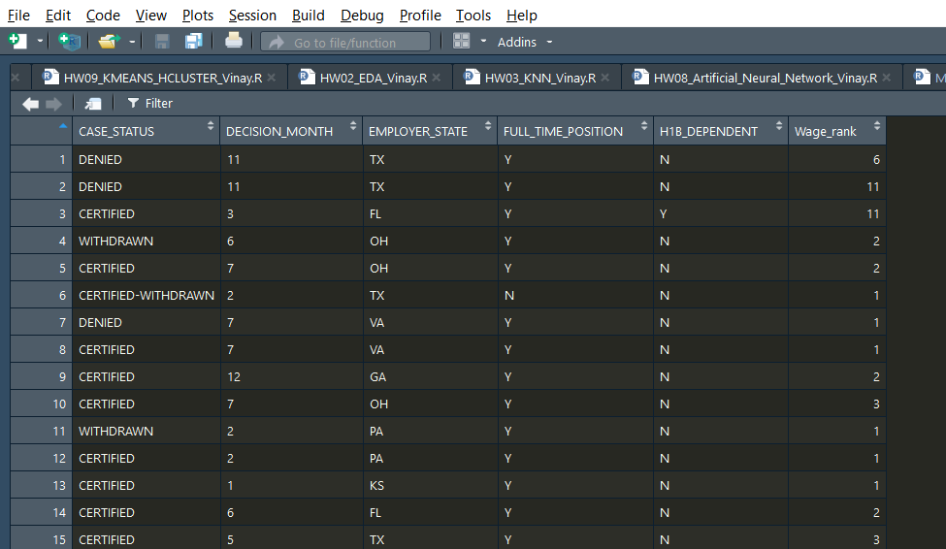
Selected Attributes

Slide 15
Algorithms Used
Exploratory Data Analysis
Naïve Bayes
K-Nearest Neighbors (K-NN)
Decision Tree: CART
Decision Tree: C 50

Slide 16
Exploratory Data Analysis (EDA)
Exploratory Data Analysis (EDA) is an approach/philosophy for data analysis that employs a variety of techniques (mostly graphical) to maximize insight into a data set;
uncover underlying structure
extract important variables
detect outliers and anomalies
test underlying assumptions
develop parsimonious models
determine optimal factor settings
The EDA approach is precisely that--an approach--not a set of techniques, but an attitude/philosophy about how a data analysis should be carried out.

Slide 17
Exploratory Data Analysis (EDA)

Slide 18
Exploratory Data Analysis (EDA)

Slide 19
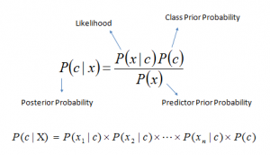
Naïve Bayes
It is a classification technique based on Bayes’ Theorem with an assumption of independence among predictors. In simple terms, a Naive Bayes classifier assumes that the presence of a particular feature in a class is unrelated to the presence of any other feature
P(c|x) is the posterior probability of class (c, target) given predictor (x, attributes).
P(c) is the prior probability of class.
P(x|c) is the likelihood which is the probability of predictor given class.
P(x) is the prior probability of predictor
Accuracy: 93.88%

Slide 20
K-Nearest Neighbors
In Pattern recognition and statistical estimation, the k-nearest neighbors algorithm is used for classification and regression.
For classification, K-nearest neighbors is a simple algorithm that stores all available cases and classifies new cases based on a distance matrix.
Euclidean Distance Function

Slide 21
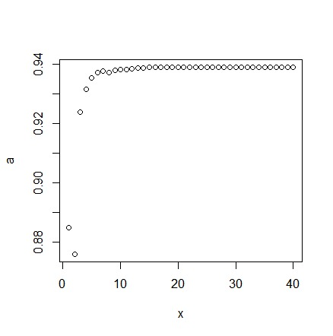
K-NN Graph
K Means Accuracy where k is from 1 to 40

Slide 22
Classification and Regression Tree
The purpose of the analysis via tree-building algorithm is to determine a set of if-then logical split conditions that permit accurate predictions or classification of cases.
A Classification tree will determine a set of logical if-then conditions instead of linear equations for predicting or classifying cases.
The general approach to derive predictions from if-then conditions can also be applied to regression tree as well.
Advantages of CART:
Simplicity
Nonparametric and Nonlinear

Slide 23
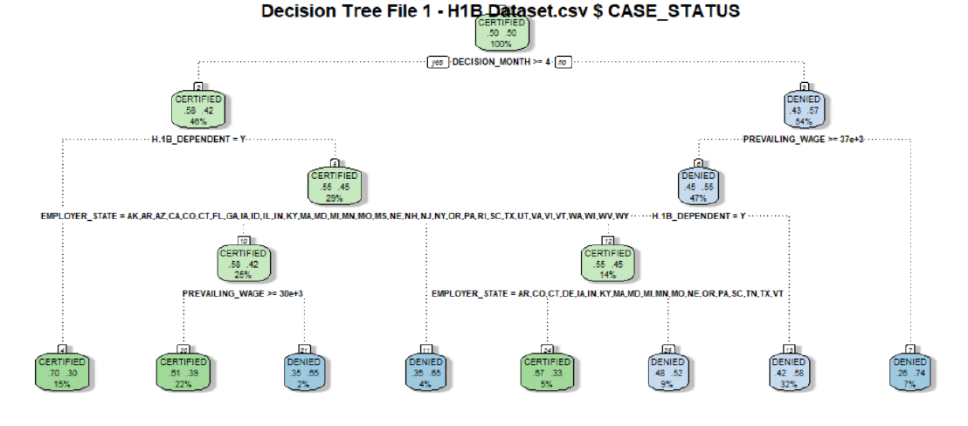
CART Implementation
Accuracy: 93.88%

Slide 24
C5.0 Algorithm
C5.0 algorithm is used to generate decision tree that can be used for classification and so referred as Statistical Classifier.
C5.0 permits numeric attributes and deals sensibly with missing values.
C5.0 uses attributes with continuous data and different weights.
C5.0 follows Post-pruning approach to deal with noisy data and remove a sub-tree from fully developed decision tree.

Slide 25
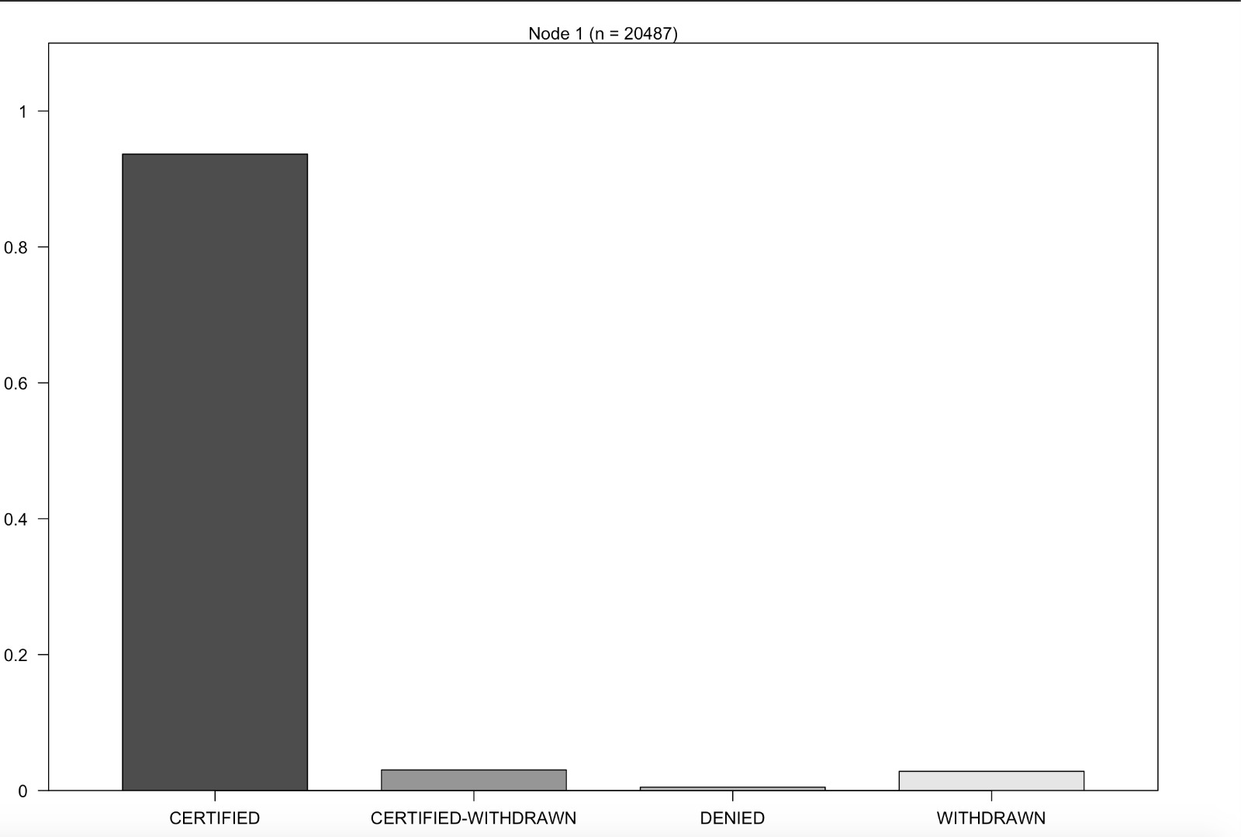
C5.0 Decision Tree
Accuracy: 94.28%

Slide 26
Modeling Complications
The dataset we choose has 600k row and to run the entire was not possible on the compute power available.
This made us take a small subset of the entire dataset to be able to get the appropriate models.
Out of all the column chosen some had more than 50 levels. This made more difficult to process the models.
This helped us achieve increased model accuracy

Slide 27
Future Scope
The following steps can be used to make the model more accurate and usable in the real world-
1. Adding practical contemporary variables which can influence the modeling decision. For example, STEM/Non-Stem, Nationality, Highest degree of education
2. Using an updated database as the visa trends keep on changing and the database needs to be updated frequently

Slide 28
Conclusion
Outcome:
After studying different models on the dataset, it is observed that C5.0 provides us the best results with the accuracy of about 94%.
Application:
Deployment for the project can be in the form of an interactive Web Based Platform, where users can log in, enter their details as per the model requirement and get the predictions as a result
A website or an application can be used to launch the model for direct customer use
The model can also be extended to predict visa status of other visa types, subject to availability of database

Slide 29
Thank You!

